Slide 1

Presentation On Online Private Tutor Finding System

Slide 2
Supervised By:-
T. M. Amir - Ul - Haque Bhuiyan
Assistant Professor
Department of CSE
BUBT
Presented by:-
Dipta Kumar Saha
19202103216
Md. Siam Hossain
19202103228
Md.Nahidul Islam
19202103136
Ayon Fardous
19202103222
Md. Shamim Akter Jewel
19202103157

Slide 3

Outline
Introduction
Methodology
Hardware & Software
Implementation
Testing & Result
Result & Conclusion

Slide 4

INTRODUCTION
An application with the aim of making it easier for tutors and students.
To instantly find and connect with thousands of professional and certified tutors at one place.
The search engine which will help the students to search their specific tutor with different filters.
Also integrate Search by Location feature to help the users to search the tutors in their surrounding locations.
Make this application more useful to the other users.

Slide 5
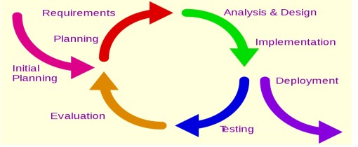
METHODOLOGY

Slide 6
Hardware and Software Requirement
Hardware Requirement
Software Requirement
Processor:-2.50 GHz
Ram:- 8GB
Hard Disk:- 500GB
Monitor:- Color monitor
Mouse:- Optical Mouse
Keyboard:-MM Keyboard
Operating System:- Windows-10
Front- end:-JAVA Script ,HTML & CSS
Back-end:-MySQL & Php

Slide 7
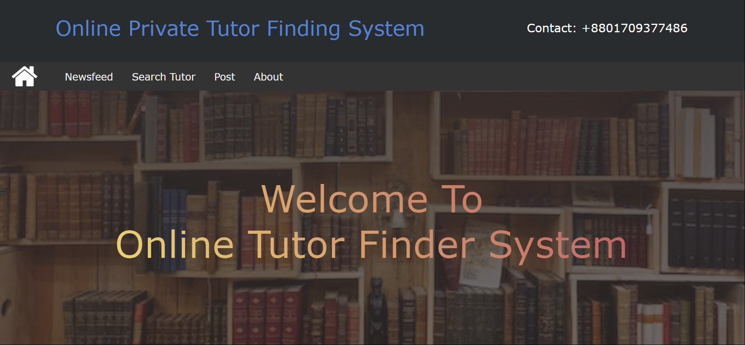
Administrator Module
Figure 4.1: System main Interface

Slide 8
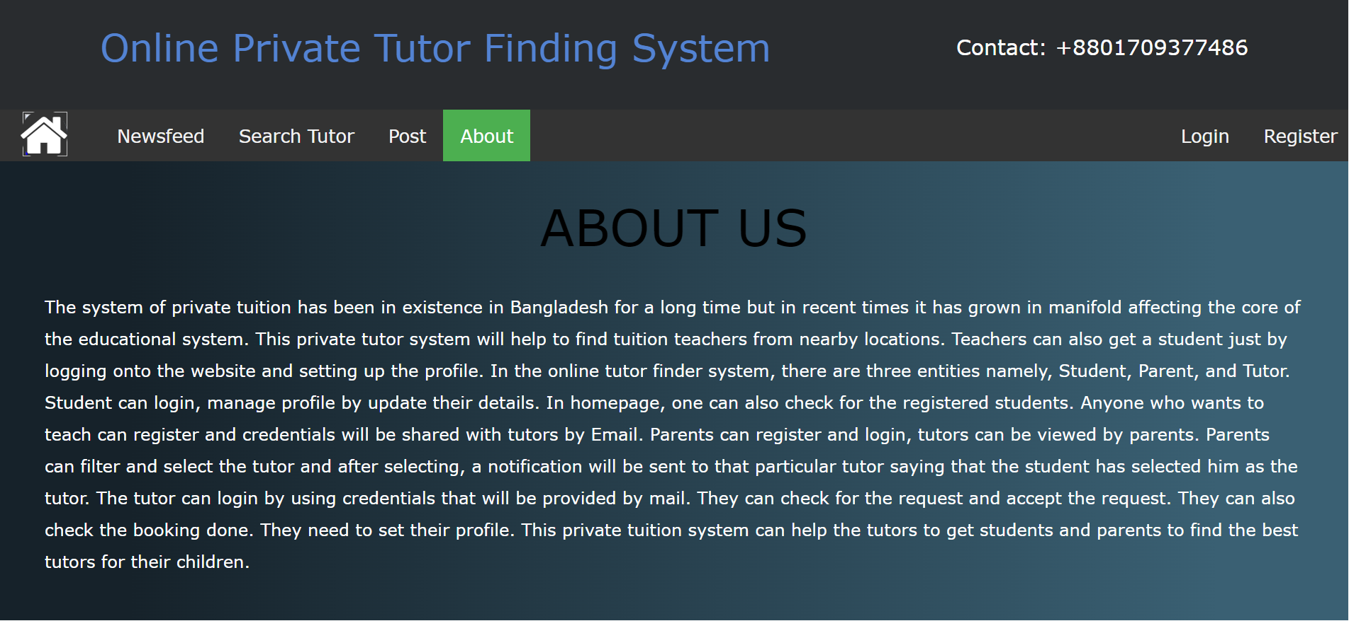
ABOUT US

Slide 9
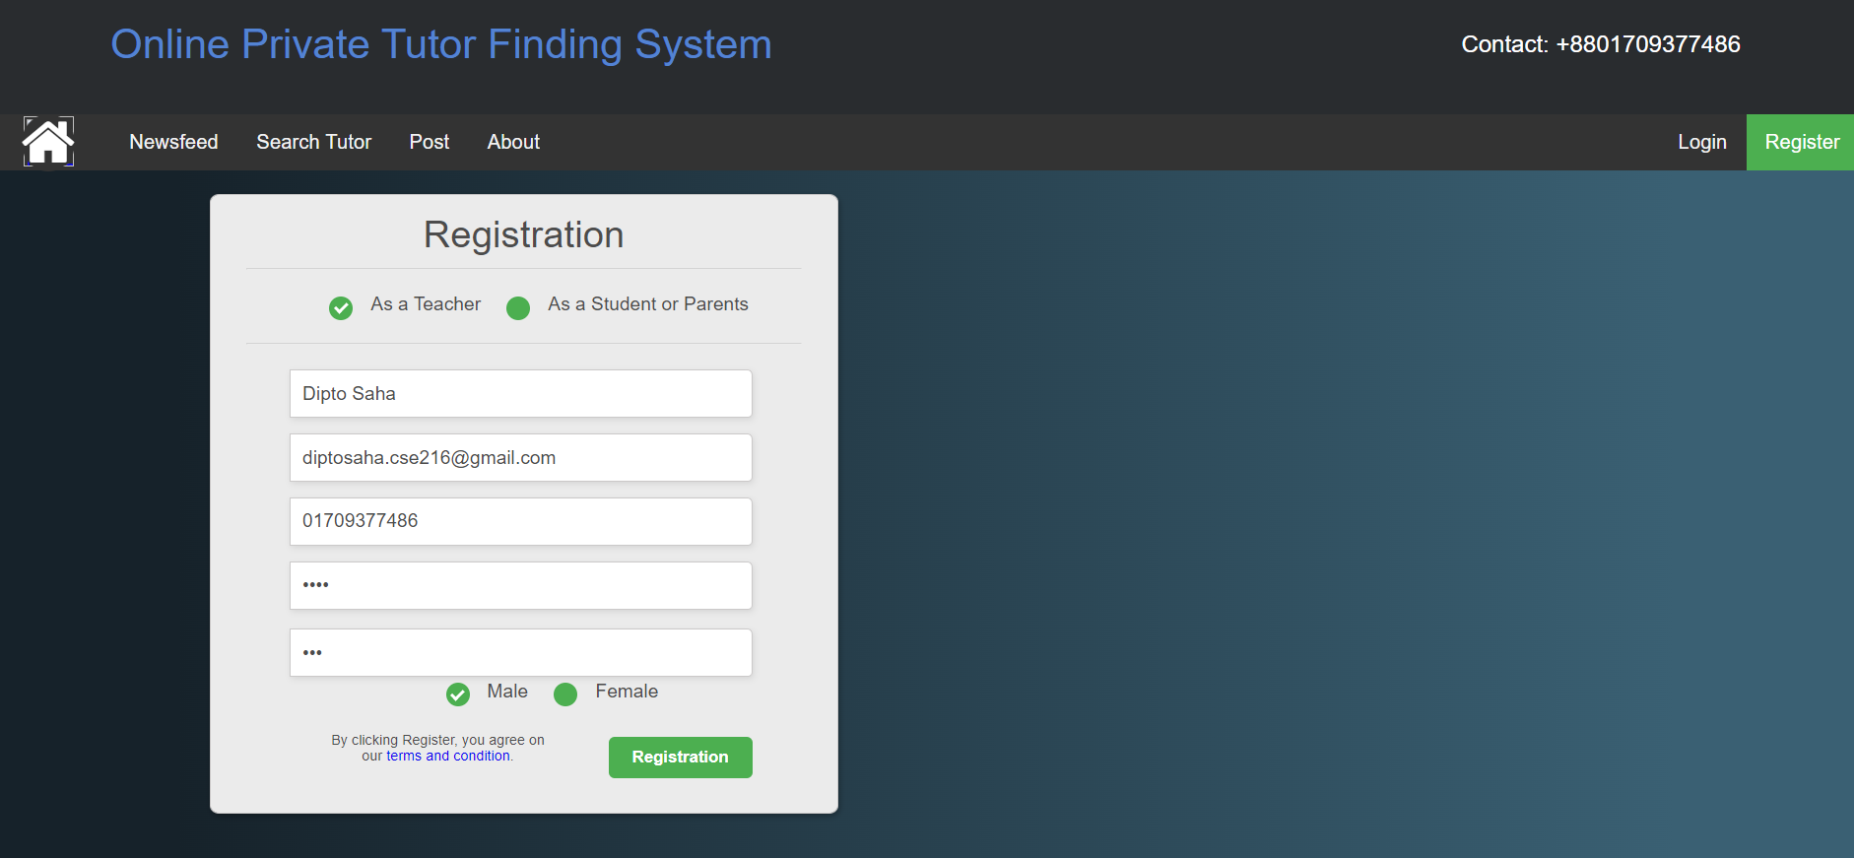
Registration PAGE

Slide 10
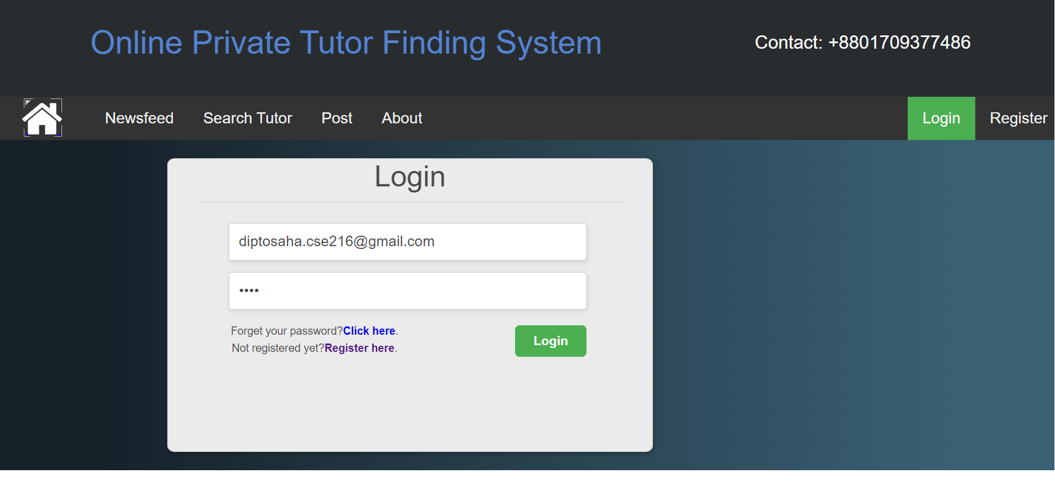
LOGIN PAGE

Slide 11
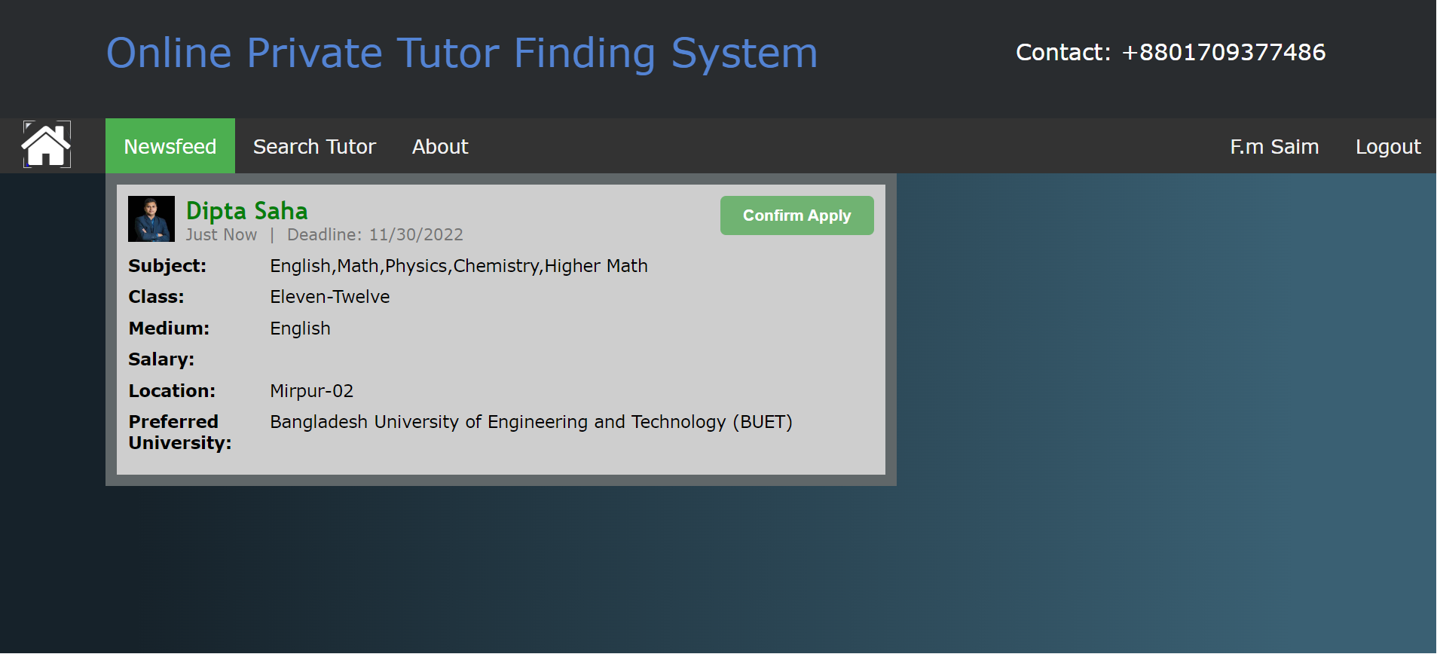
TUTOR PROFILE PAGE

Slide 12
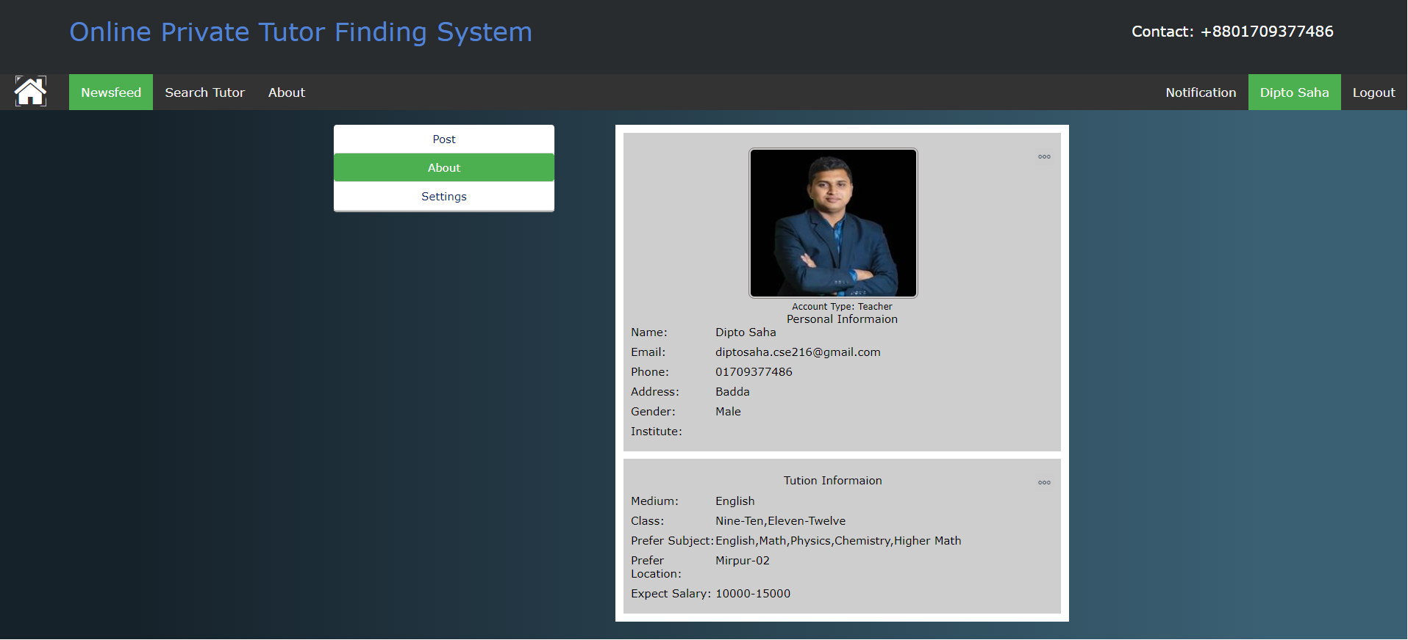
TUTOR PROFILE PAGE

Slide 13
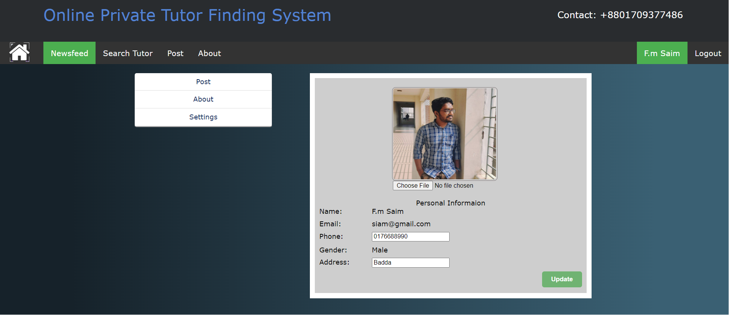
STUDENT PROFILE PAGE

Slide 14
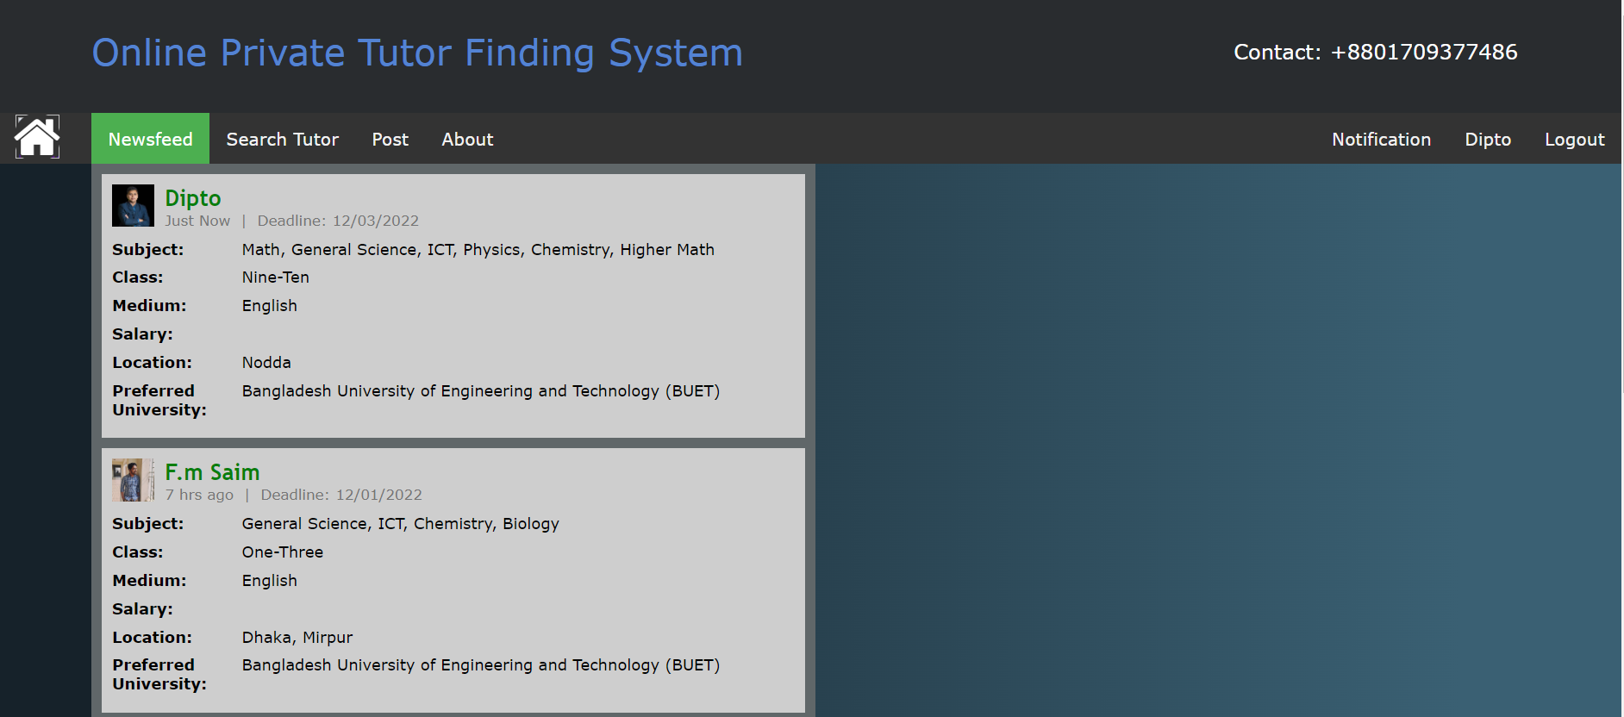
NEWSFED FOR STUDENT

Slide 15
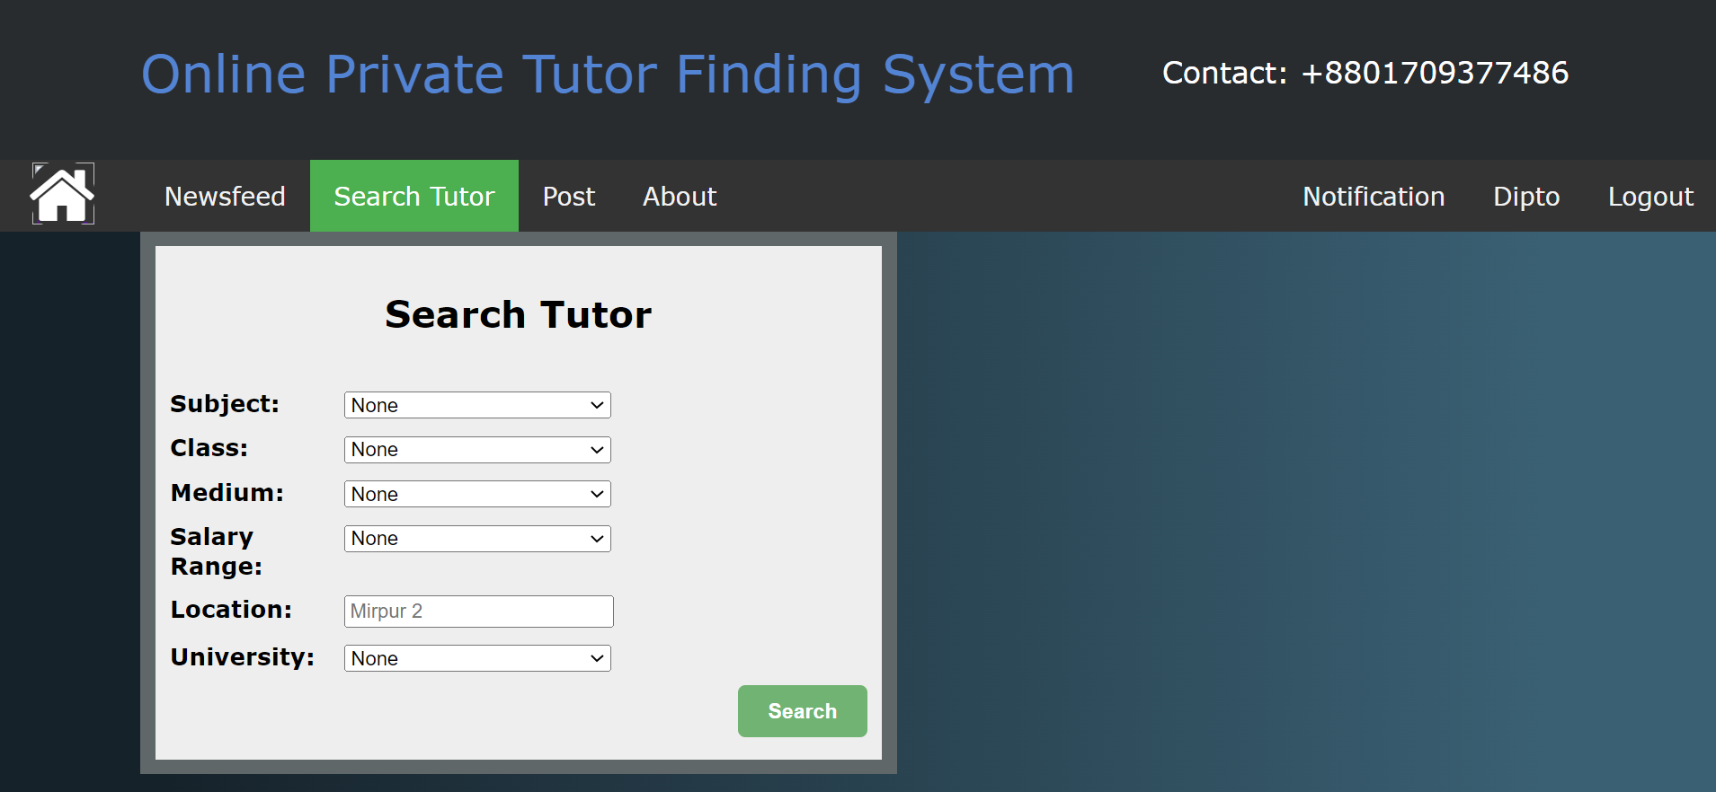
Search tutor page

Slide 16
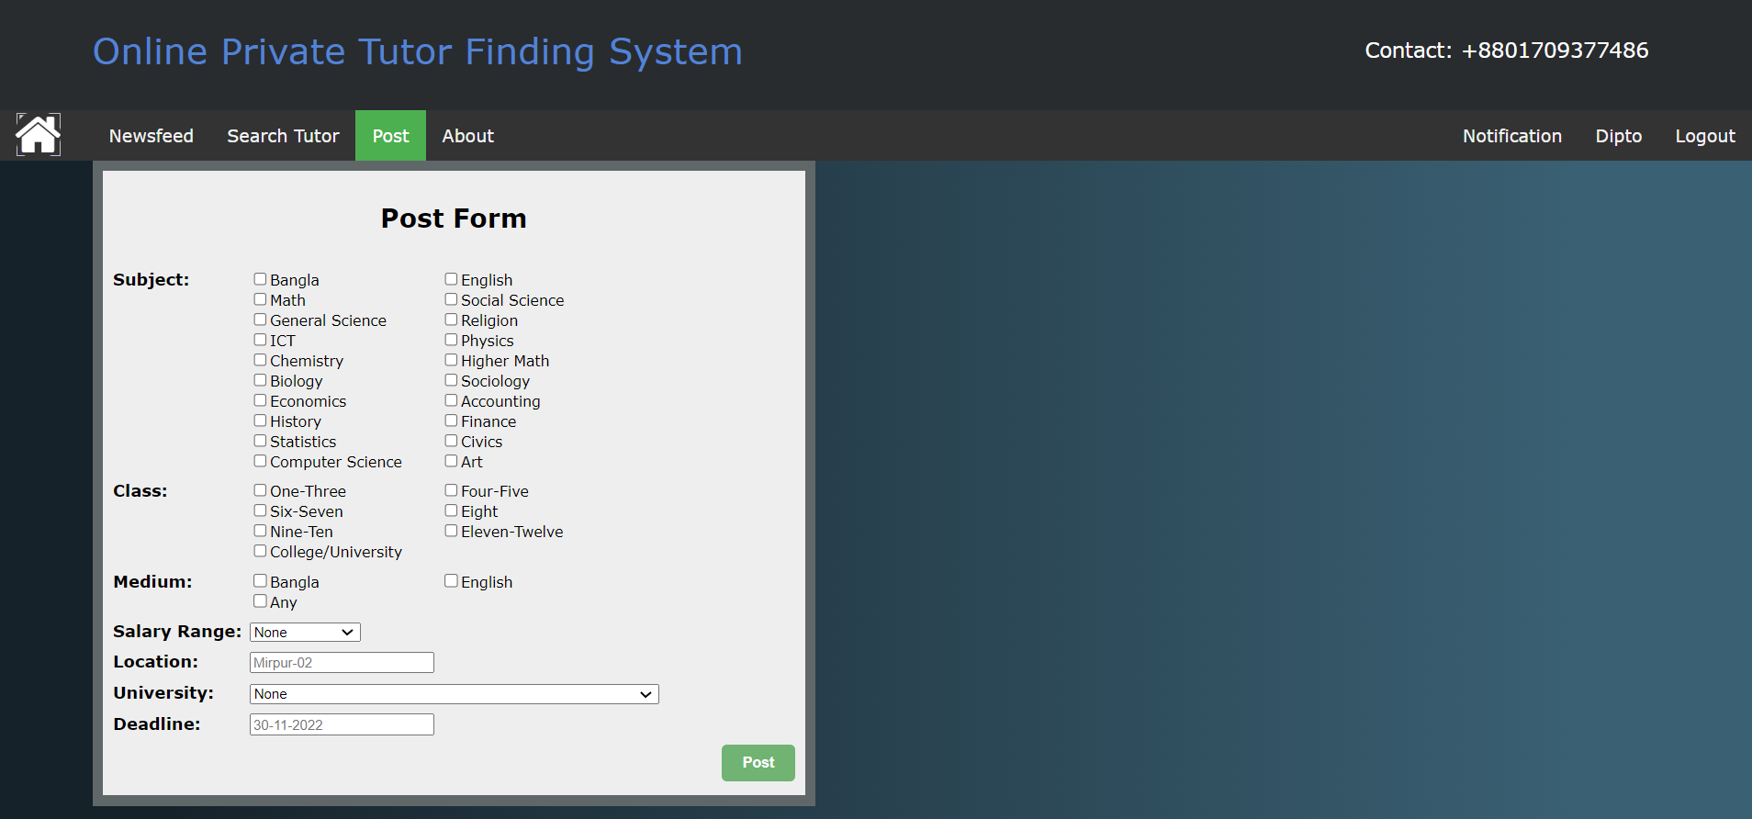
TUTION POST PAGE

Slide 17
TESTING AND RESULT
Testing Analysis
Black Box Testing
Test Cases

Slide 18
RESULT AND Discusssion
Project Contribution
Result Discussion
Project Constraints and Limitation
Future Work
Conclusion

Slide 19
REFERENCES
[1] B. Sanghavi, R. Rathod, and D. Mistry, “Recommender Systems - Comparison Of Content-Based Filtering And Collaborative Filtering,” Int. J. Curr. Eng. Technol., vol. 4, no. 5, pp. 3131–3133, 2014, [Online]. Available: http://inpressco.com/wpcontent/uploads/2014/09/Paper73131-3133.pdf.
[2] Y. Zhang, W. Ren, T. Zhu, and E. Faith, “MoSa: A modeling and sentiment analysis system for mobile application big data,” Symmetry (Basel)., vol. 11, no. 1, pp. 1–16, 2019, doi: 10.3390/sym11010115.
[3] S. Philip, P. B. Shola, and A. Ovye, “Application of Content-Based Approach in Research Paper Recommendation System for a Digital Library,” Int. J. Adv. Comput. Sci. Appl., vol. 5, no. 10, pp. 37–40, 2014, doi: 10.14569/ijacsa.2014.051006.
[4] Das, S., & Das, S. (2015, September 24). Beginners Guide to learn about Content Based Recommender Engine. Retrieved from https://www.analyticsvidhya.com/blog/2015/08/beginners-guide-learn-content-basedrecommender-systems/.
[5] Nick Morrison. (2017, November 15). Why private tutoring for your child is time well invested. Retrieved from https://www.telegraph.co.uk/education/2017/10/10/privatetutoring-time-invested/
[6] Dang, Hai-Anh. (2007). The Determinants and Impact of Private Tutoring Classes in Vietnam. Economics of Education Review. 26. 683-698. 10.1016/j.econedurev.2007.10.003

Slide 20



